Slide 1
Concerto Content Instructions
Login
Screen
Template
Feed
Ticker Text
Image
Dynamic
Subscriptions

Slide 2
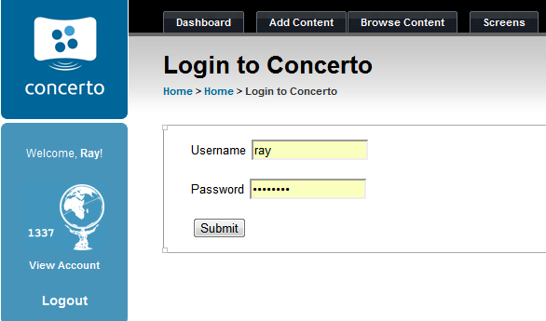
Login
Go to - http://184.73.162.78/concerto/
Create a user name and password
You will then need to be granted admin access

Slide 3
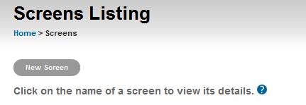
Create Screen
From the Dashboard select the Screens tab
Click New Screen
Add new Screen Name
Fill in the Screen Size
Input MAC Address for corresponding screen
Select Template for screen
Click Create Screen

Slide 4
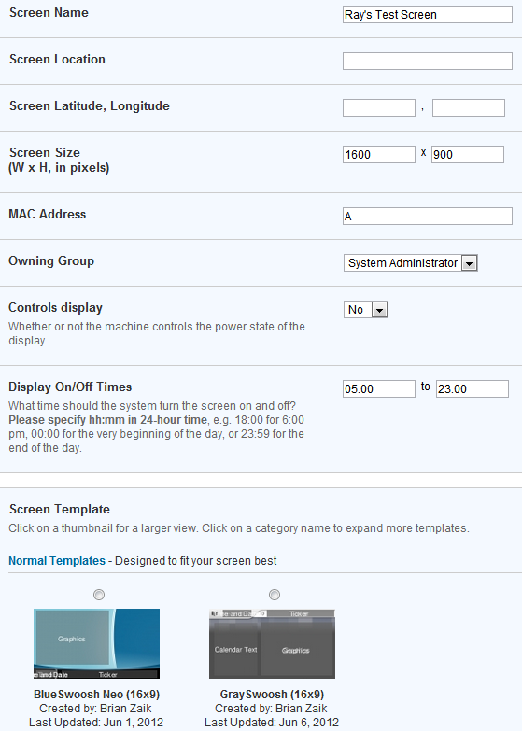
Create Screen Cont.

Slide 5
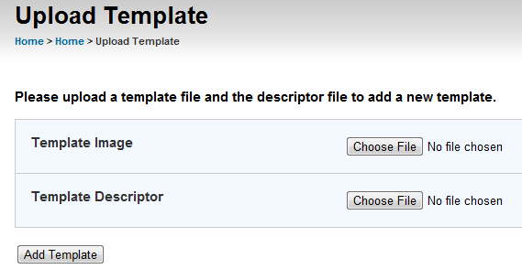
Create Template
From the Concerto Dashboard page select the Admin Tab
At the bottom select the Template Up loader link

Slide 6
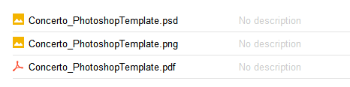
Template Image
To create a Template Image File open a Template image file
Delete current text and images
Replace with your design
Save file as a .jpg

Slide 7
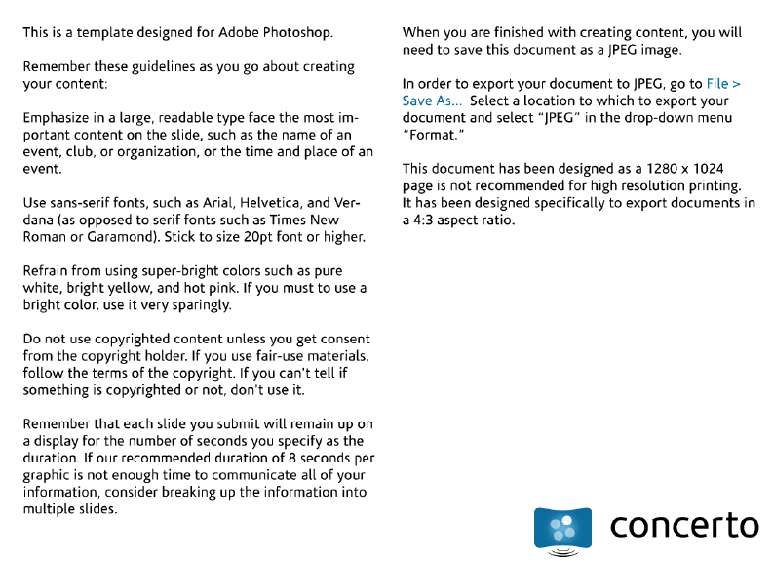
Template Image File

Slide 8
Template Descriptor
<template>
<name>Blue Swoosh Neo</name>
<width>1920</width>
<height>1080</height>
<field>
<name>Time and Date</name>
<type>Text</type>
<style>font-weight:bold !important; letter-spacing:.12em !important;</style>
<left>0.024</left>
<top>0.885</top>
<width>0.156</width>
<height>0.089</height>
</field>
</template>

Slide 9
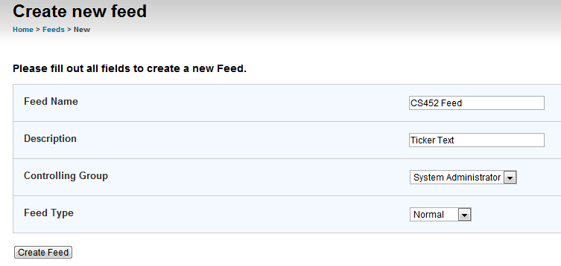
Create New Feed
From the Dashboard select the Browse Content tab
Click New Feed Button
Enter a Feed Name and Description
Select System Administrator for Controlling Group
Select Normal for Feed Type

Slide 10
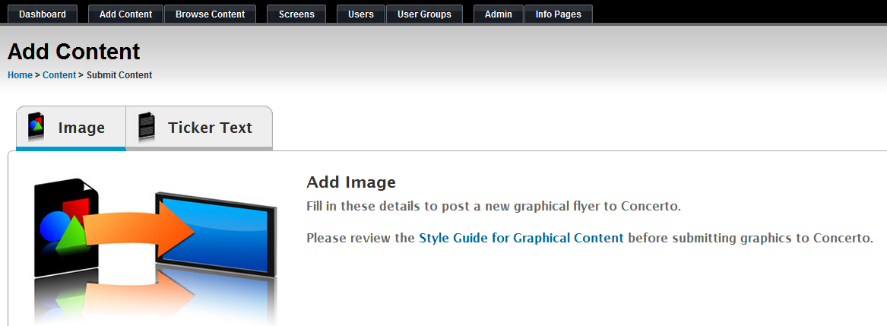
Add Image Content
From the Dashboard select the Add Content tab
Click Image Tab

Slide 11
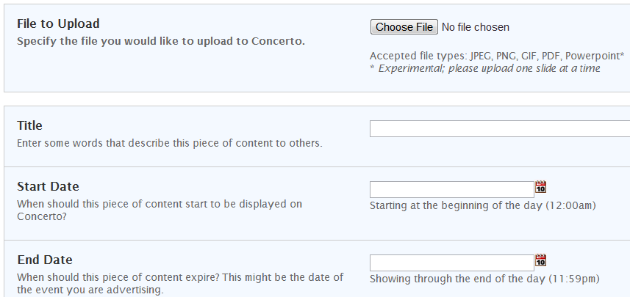
Image Content Cont.
Choose Image File
Enter Title of Image
Enter Start and End Date
Set Duration Time
Use Drop Down to Select Desired Feed

Slide 12
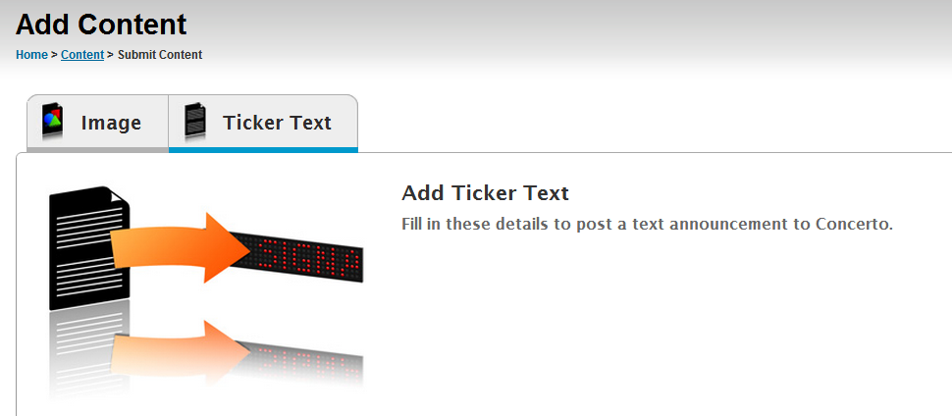
Add Ticker Text Content
From the Dashboard select the Add Content tab
Click Ticker Text Tab

Slide 13
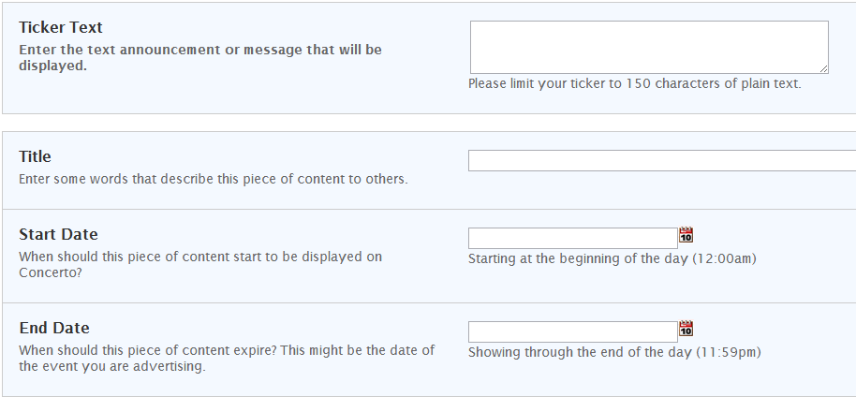
Ticker Text Content Cont.
Enter Ticker Text Content
Enter Title of Ticker Text
Set Start and End Date
Set Duration Time
Use Drop Down to Select Desired Feed

Slide 14
Create Dynamic Content
The next slides will walk through the creation of a dynamic feed on phpMyAdmin.
How to set up the RSS feeds used in this project.
How to use the rule sets

Slide 15
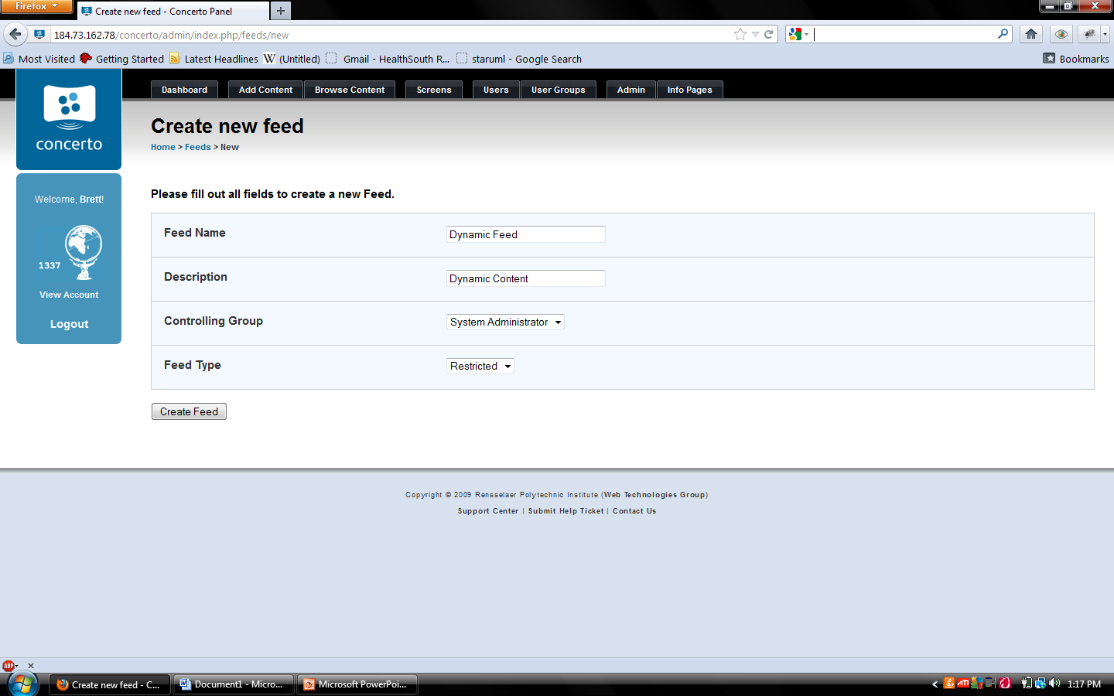
Dynamic Content
First create a feed by logging into concerto, go to browse content and click on new feed
Next name your feed, give it a description, set Controlling Group to System Administration, Feed Type to Restricted and click Created Feed.

Slide 16
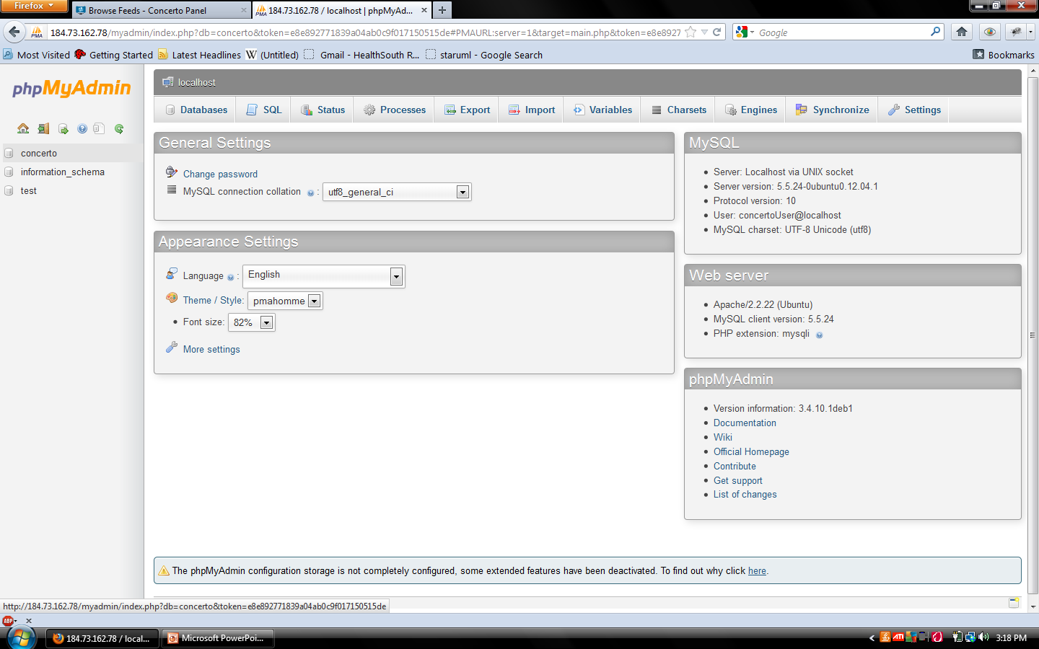
Dynamic Content
Log into http://184.73.162.78/myadmin, Username: concertoUser Password: cs452concerto
Click on the concerto database

Slide 17
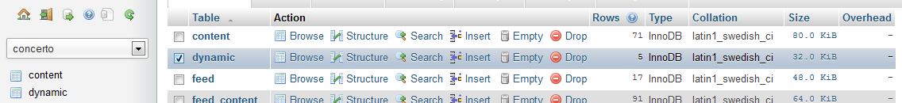
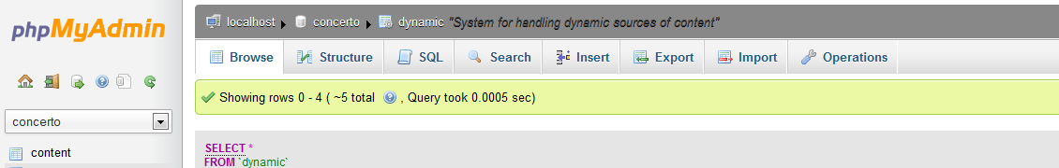
Dynamic
Click on dynamic
Click Insert

Slide 18
Dynamic
Enter an ID.
Set type to 1.
Enter RSS feed URL in path.
Enter rule set, it is obtained from concerto website. http://www.concerto-signage.org/help_pages/39. This has a generic rule set that has to be un-serialized to be altered, then re-serialized to be implemented.
Leave update interval and last update blank.
Click Go.

Slide 19
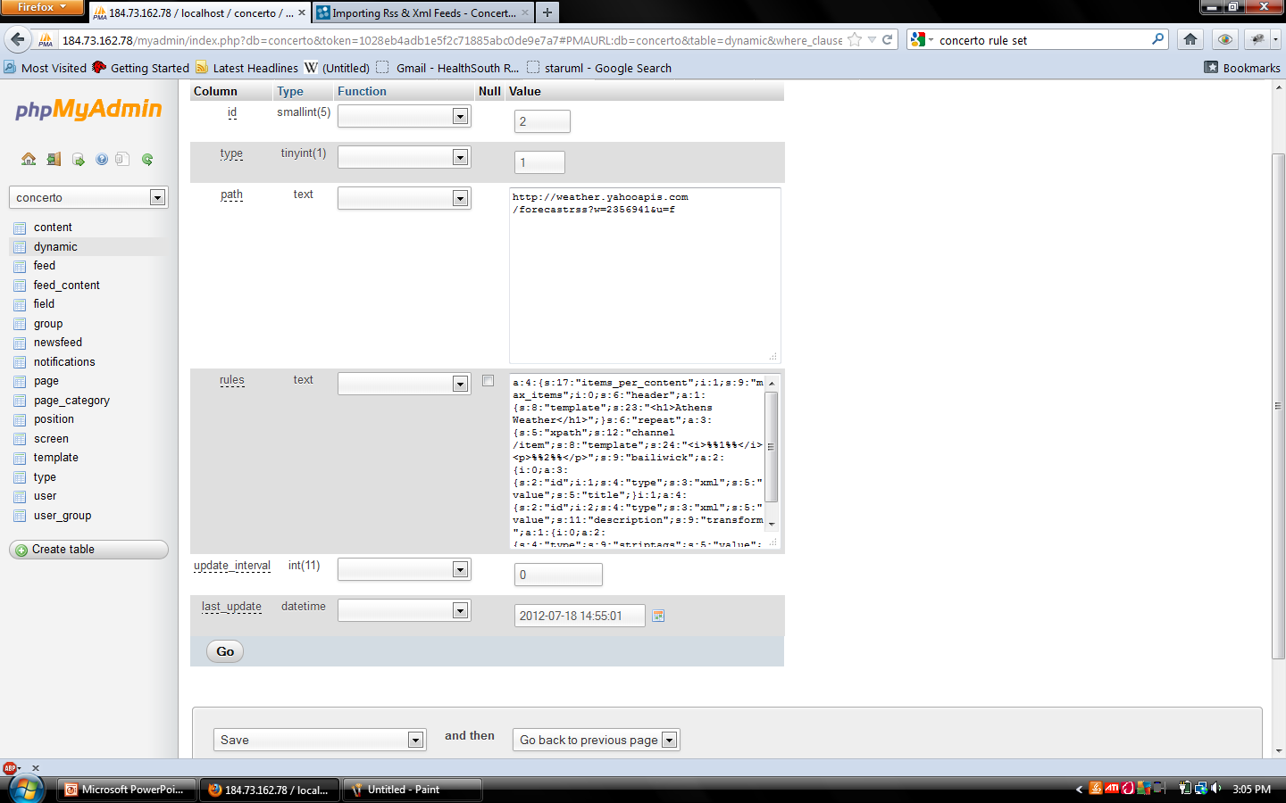
Dynamic

Slide 20
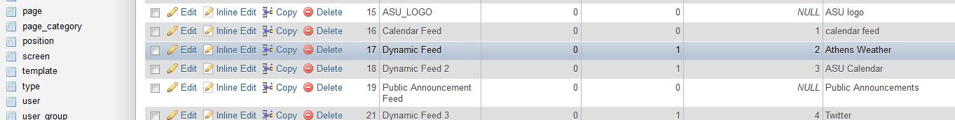
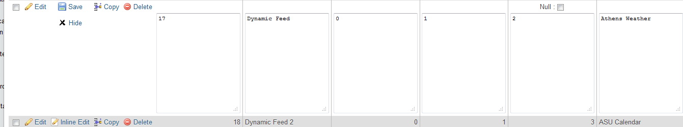
Dynamic
Click on feed then click inline edit on the feed you created.
Change the type to 1 and choose the id of the dynamic content you created.

Slide 21
Dynamic
Creating Twitter feed
Just put your username after the equals sign: https://api.twitter.com/1/statuses/user_timeline.rss?screen_name= .
User name is obtained from the URL on the page you wish to make into an RSS feed.
For example: http://twitter.com/athensstuniv

Slide 22
Dynamic
Creating Weather Feed
Enter the city code after the equals sign : http://xml.weather.yahoo.com/forecastrss?p= .
Go to yahoo and enter city, state or zip for the city you wish. The sequence of numbers at the end of the URL is the city code.
For example, the yahoo URL for Athens, AL: http://weather.yahoo.com/united-states/alabama/athens-2356941/

Slide 23
Dynamic
Creating Facebook feed
Just put the Facebook user id after the first equals sign: http://www.facebook.com/feeds/page.php?id=_______&format=rss20.
User id is obtained by going to the specific facebook you want, click photos then click a specific album. The id is after the third period after the equals sign.
For example: http://www.facebook.com/media/set/?set=a.285078330872.186523.241404700872&type=3

Slide 24
Dynamic
Creating ASU Calendar Feed
Create login in to Feed43.com Username: ASUCS452 Password: cs452concerto
Following slides give step by step to setup
Enter created URL into path of dynamic feed.

Slide 25
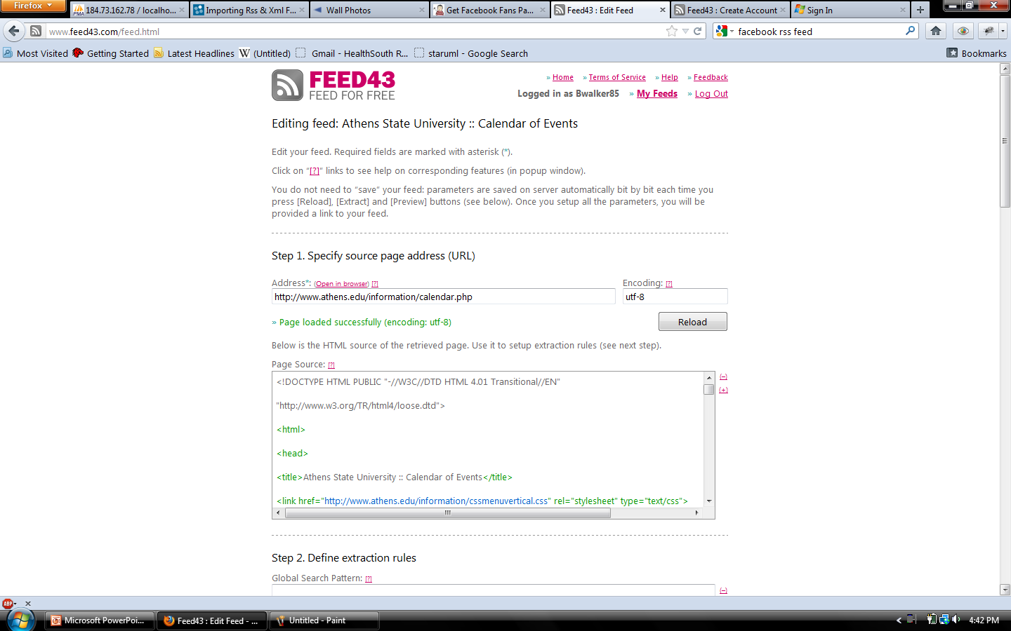
Dynamic
Type in URL and click Reload.
Then look through html tags to determine which tags the text is between.

Slide 26
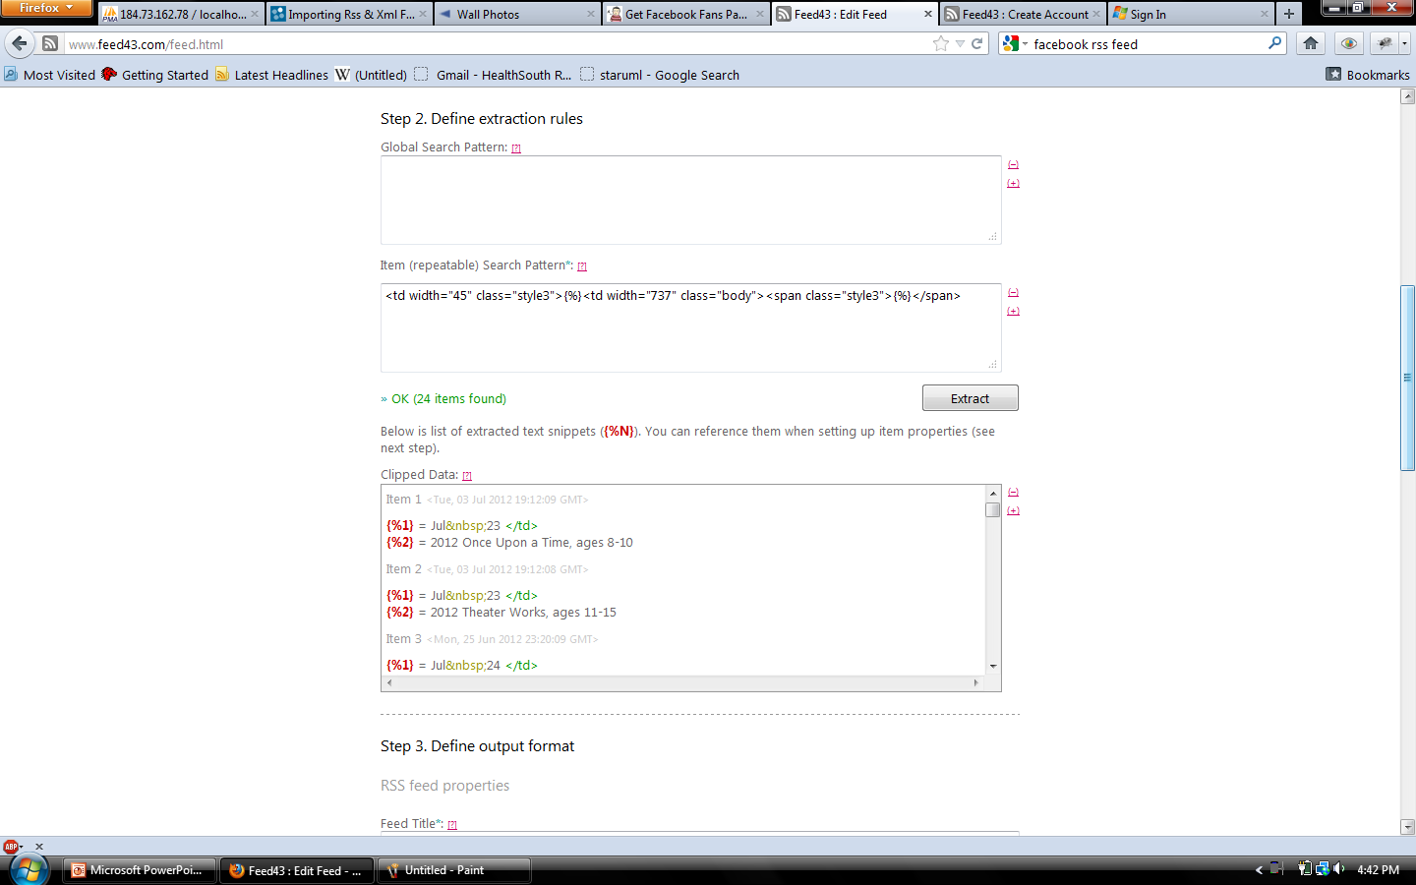
Dynamic
Type {%} between the tags you wish to extract the text

Slide 27
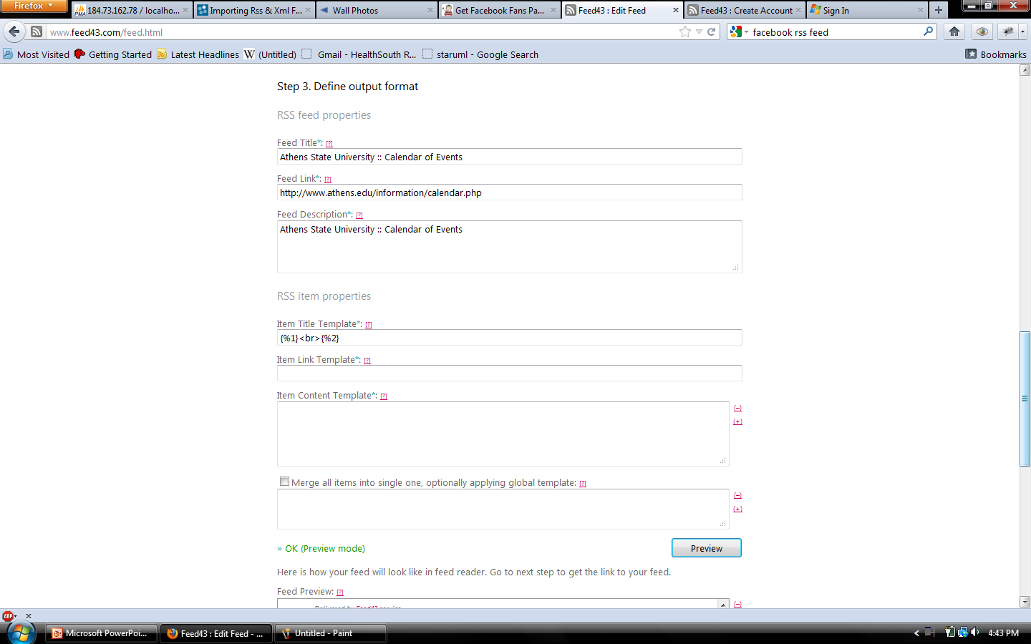
Dynamic
Type feed title, link , and description. Type <br> to adjust output text

Slide 28
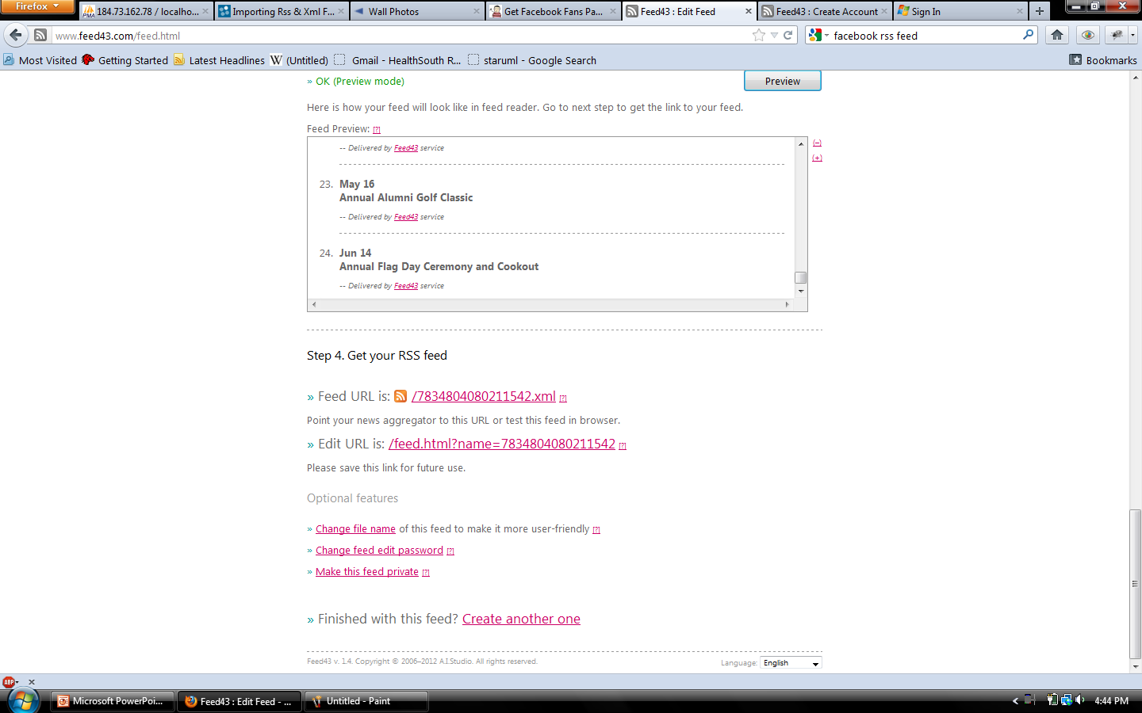
Dynamic
The URL created is http://www.feed43.com/7834804080211542.xml

Slide 29
Dynamic
Examples of Rule Sets is located at http://www.concerto-signage.org/help_pages/39
The 5 headline set and weather set was used in this project. The 5 headline was edited to 3 for facebook and twitter.
To edit the rule set it must be un-serialized.

Slide 30
Dynamic
Example of serialized rule set.
a:5:{s:17:"items_per_content";i:5;s:9:"max_items";i:0;s:6:"header";a:1:{s:8:"template";s:30:"<h1>Athens State Calendar</h1>";}s:4:"glue";a:1:{s:8:"template";s:2:" ";}s:6:"repeat";a:3:{s:5:"xpath";s:12:"channel/item";s:8:"template";s:12:"<p>%%1%%</p>";s:9:"bailiwick";a:1:{i:0;a:3:{s:2:"id";i:1;s:4:"type";s:3:"xml";s:5:"value";s:5:"title";}}}}

Slide 31
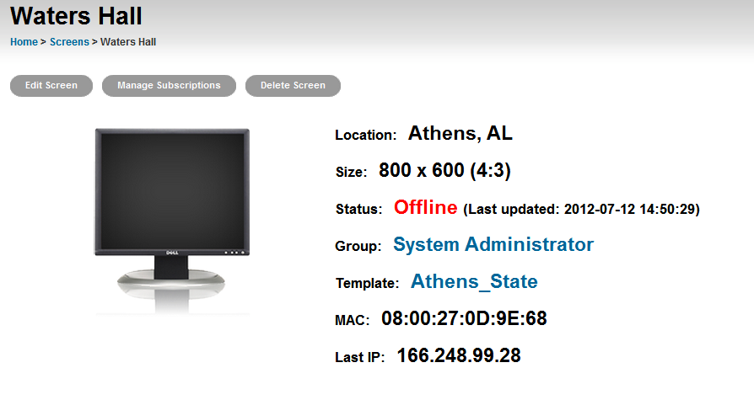
Manage Subscriptions
From the Dashboard select the Screens tab
Click Desired Screen
Click Manage Subscriptions

Slide 32
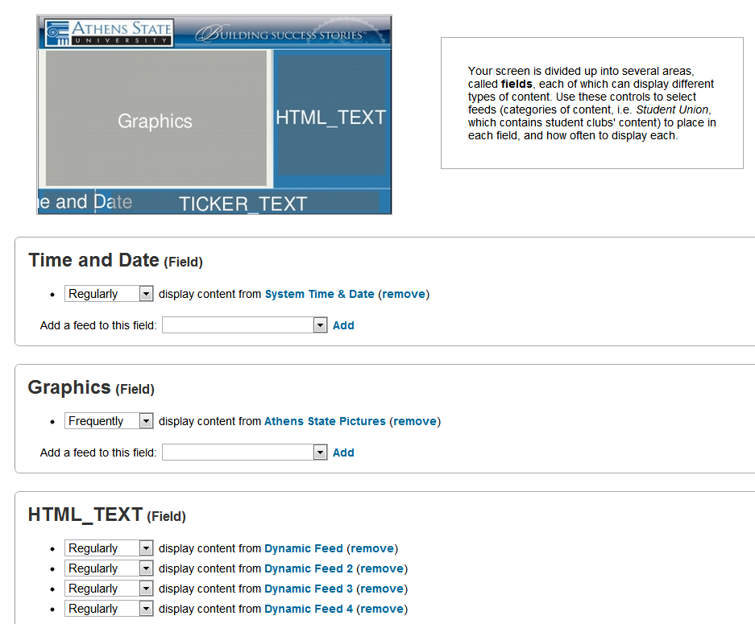
Manage Subscriptions Cont.
Use Drop Down Boxes to Select Subscription
Click Add
Use Drop Down Box to Select Frequency

